Slide 1
ENHANCING ROAD SAFETY
USING IMAGE PROCESSING TECHNIQUES

Slide 2



ENHANCING ROAD SAFETY
USING IMAGE PROCESSING TECHNIQUES
K MUGUNTHAN
AAROON D SANJU
P NAVEEN
TEAM MEMBERS

Slide 3
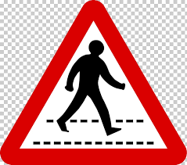
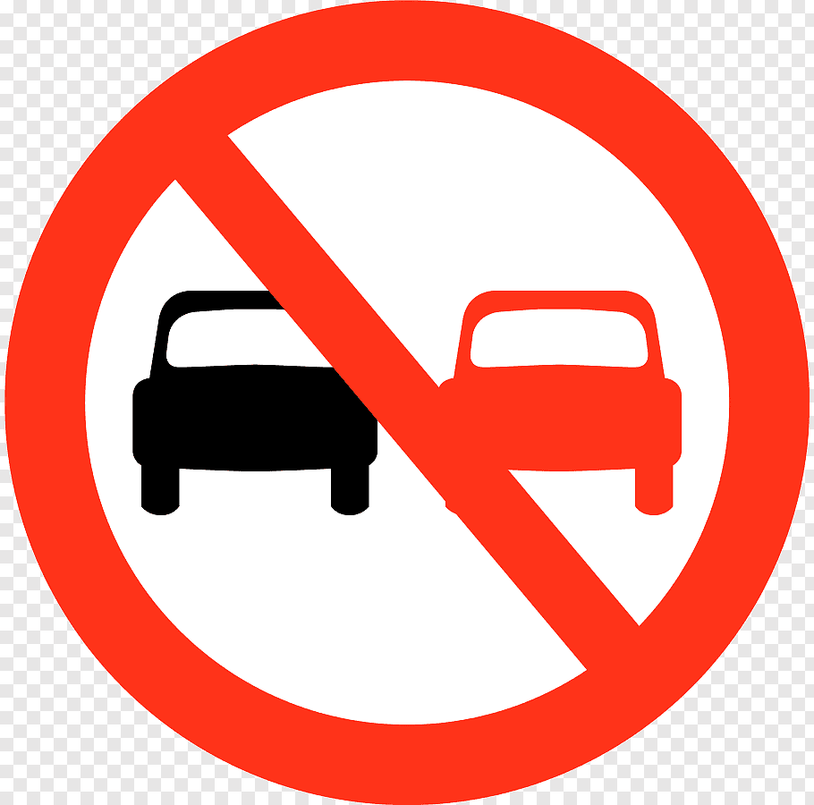
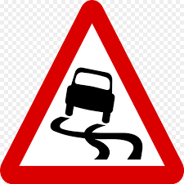
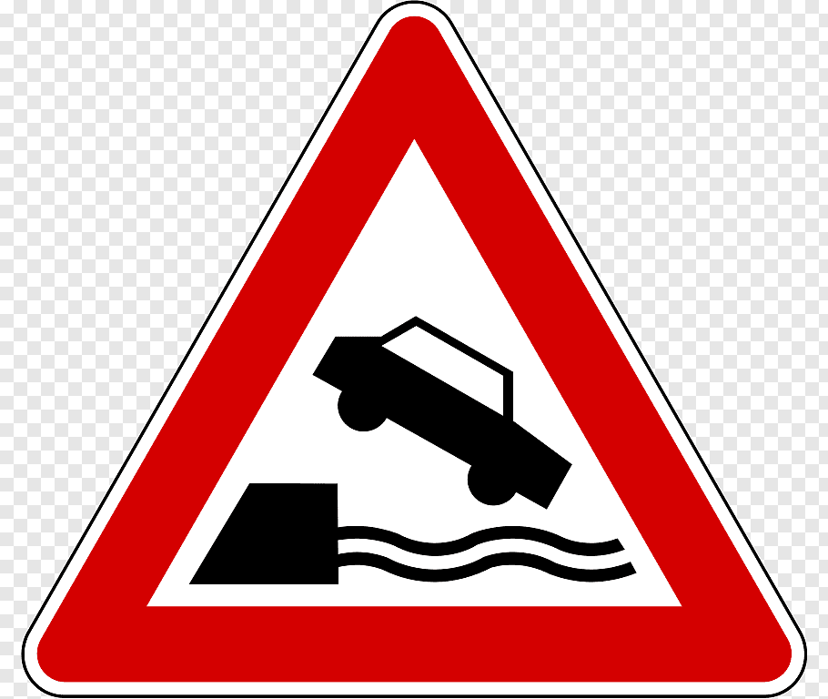

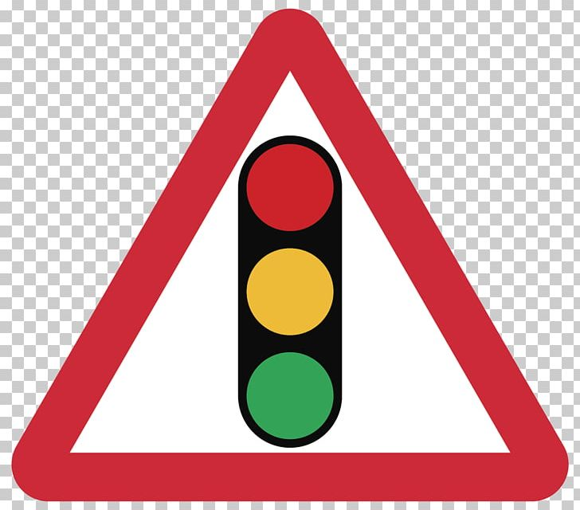
INTRODUCTION
Driver drowsiness detection is a car safety technology which helps prevent accidents caused by the driver getting drowsy. Various studies have suggested that around 20% of all road accidents are fatigue-related, up to 50% on certain roads.
Automatic number-plate recognition is a technology that uses optical character recognition on images to read vehicle registration plates to create vehicle location data. It can use existing closed-circuit television, road-rule enforcement cameras, or cameras specifically designed for the task.

Slide 4
INTRODUCTION
Smart Helmet :
The impact when a motorcyclist involves in a high speed accident without wearing a helmet is very dangerous and can cause fatality.With this reason, this project is specially developed as to improve the safety of the motorcycle's rider.
Motorcyclist will be alarmed when the speed limit is exceeded. A Force Sensing Resistor (FSR) and BLDC Fan are used for detection of the rider's head and detection of motorcycle's speed respectively. Only when the rider buckled the helmet then only the motorcycle's engine will start. A LED will flash if the motor speed exceeds 100 km/hour.

Slide 5
EXISTING SYSYEM
The existing detector detects only 40% of face of driver in normal driving position in video recording of 10 minutes.
It uses the old technology and hence there will be minimal accuracy towards detection.

Slide 6
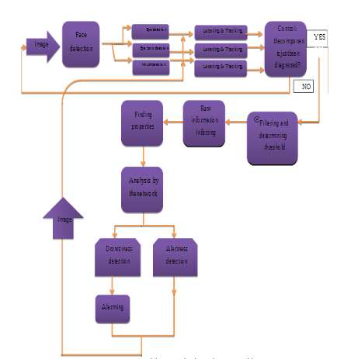
DROWSY DRIVER DETECTION
PROPOSED SYSTEM BLOCK DIAGRAM

Slide 7
DROWSY DRIVER DETECTION
Applications
This can be used by riders who tend to drive for a longer period of time that may lead to accidents
Code Requirements
The example code is in Python (Version 2.7 or higher will work).
Dependencies
import cv2
import imutils
import dlib
import scipy

Slide 8
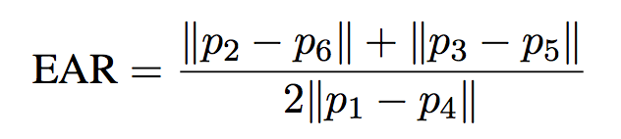
Description
A computer vision system that can automatically detect driver drowsiness in a real-time video stream and then play an alarm if the driver appears to be drowsy.
Algorithm
Each eye is represented by 6 (x, y)-coordinates, starting at the left-corner of the eye (as if you were looking at the person), and then working clockwise around the eye.

Slide 9
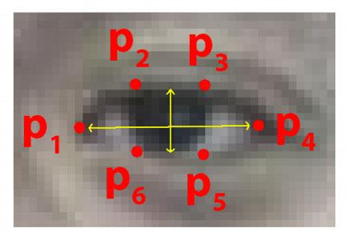
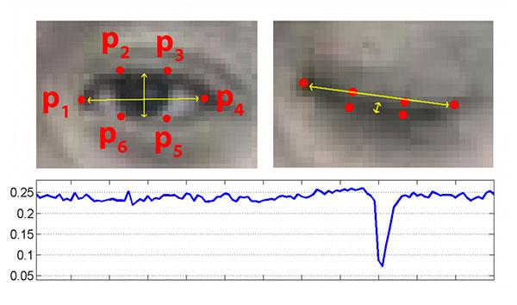
WORKING PROCESS

Slide 10
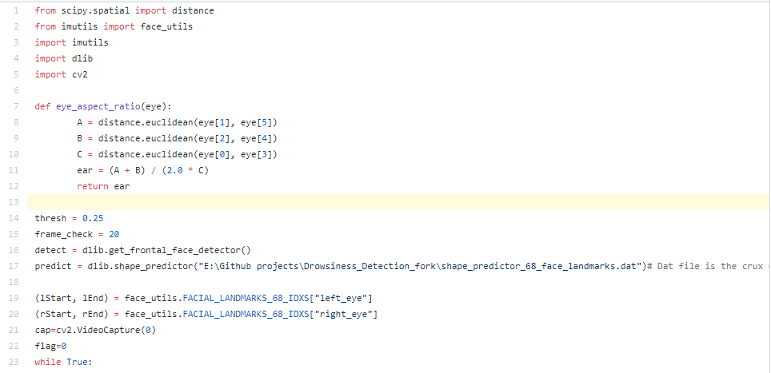
DROWSY DRIVER DETECTION SAMPLE CODE

Slide 11


Slide 12

THANK
YOU

